Slide 1

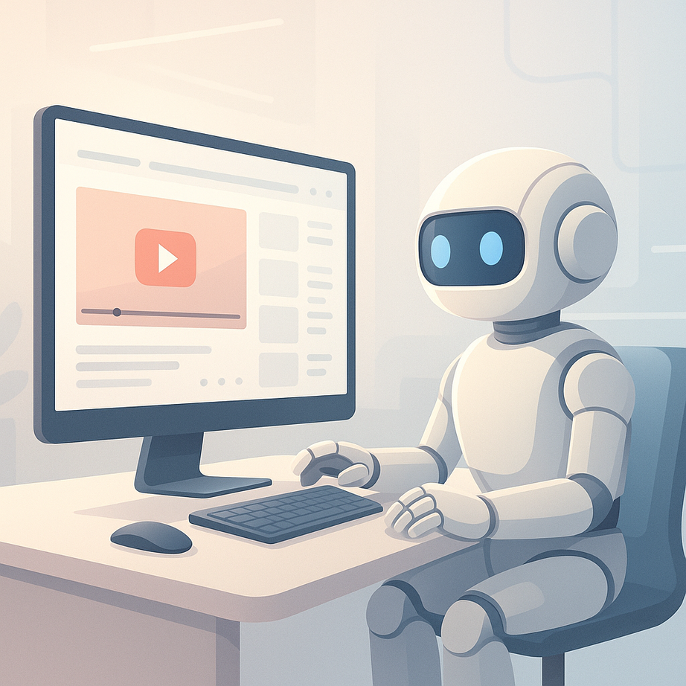

UBOT: YOUTUBE AI
Making Video Content Accessible Through AI
Bader albehishi

Slide 2


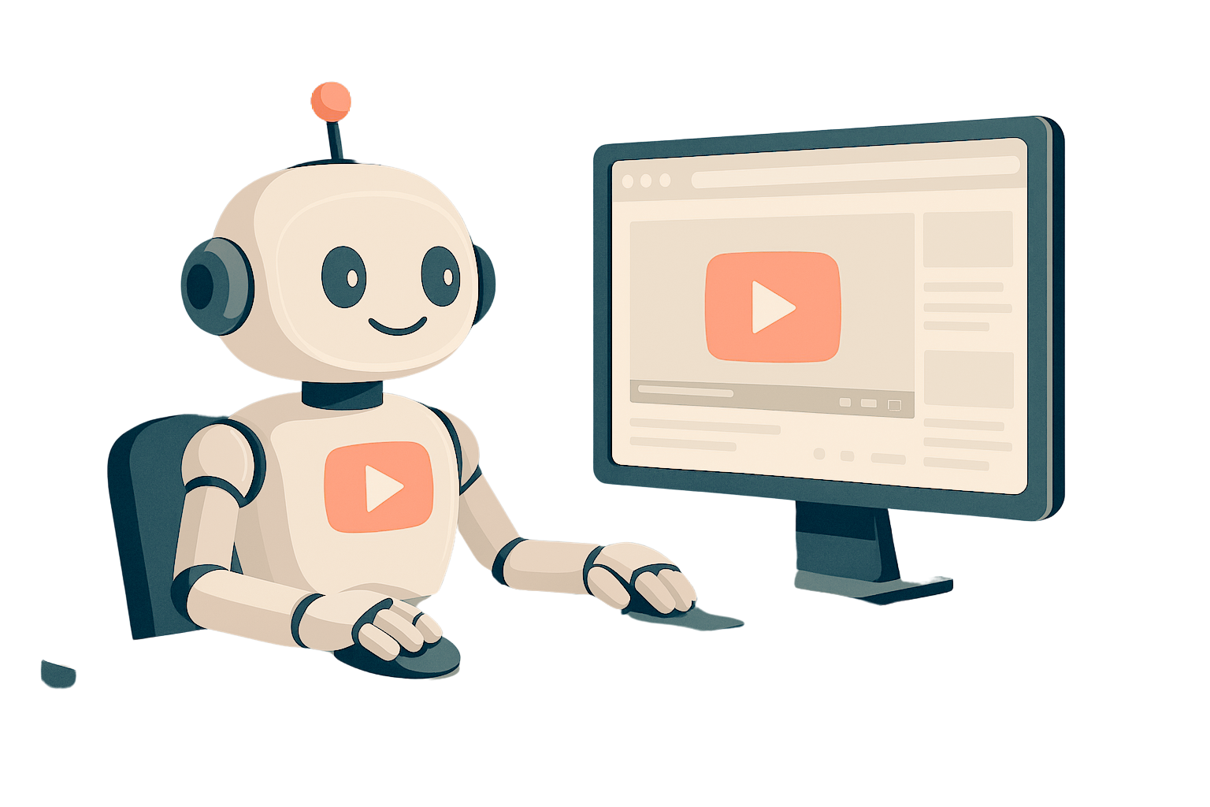
UBOT OVERVIEW
UBot is an innovative AI-driven assistant designed to enhance user engagement with YouTube content through interactive capabilities.
OBJECTIVES
Accessibility:Makes video content accessible
Information Retrieval:Enables quick extraction of specific facts from lengthy videos

Slide 3



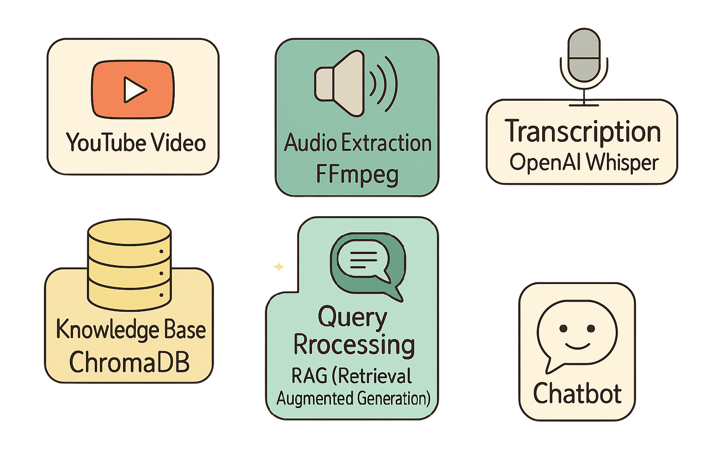

UBOT ARCHITECTURE

Slide 4

KEY INNOVATIONS
Long Video Optimization
Intelligent Conversation
Performance Optimization
Chunked processing for videosg
Distinguishes between video-related & casual queries
Multi-level caching for repeated questions

Slide 5


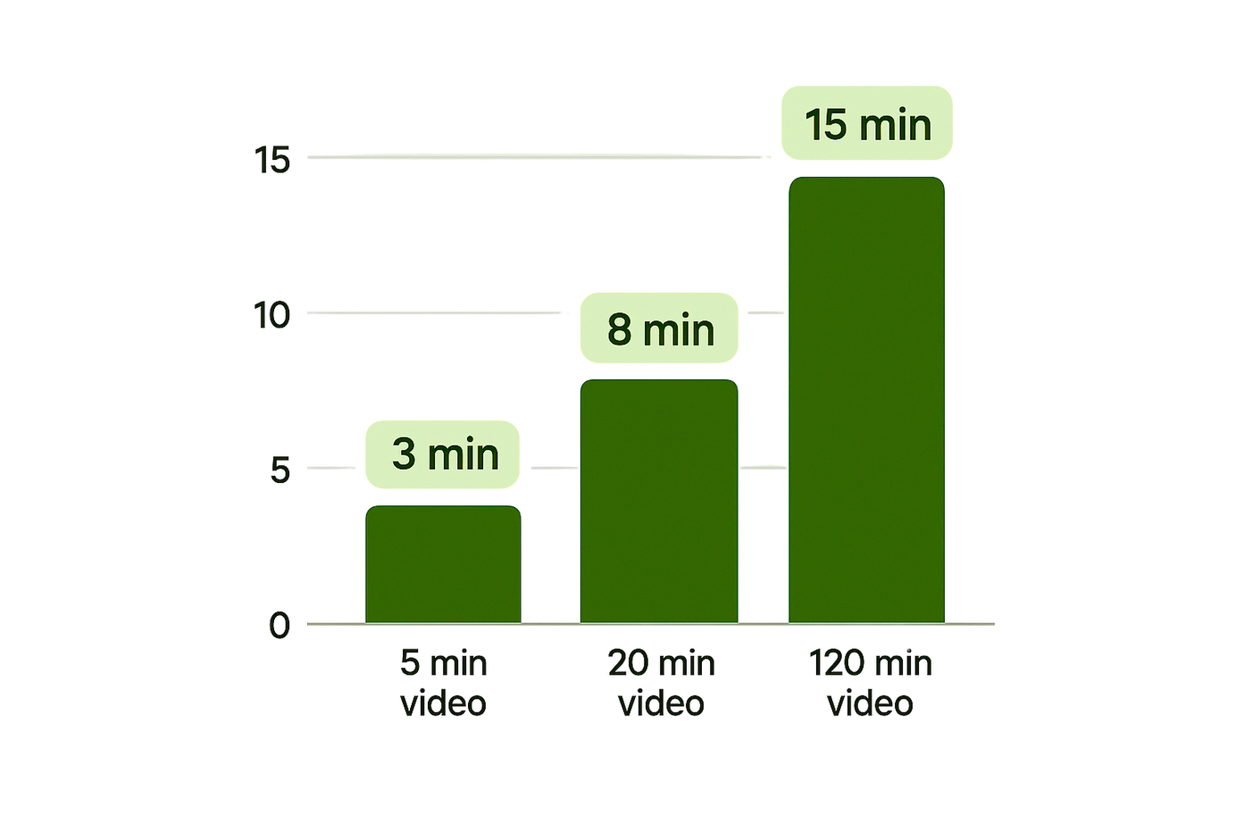
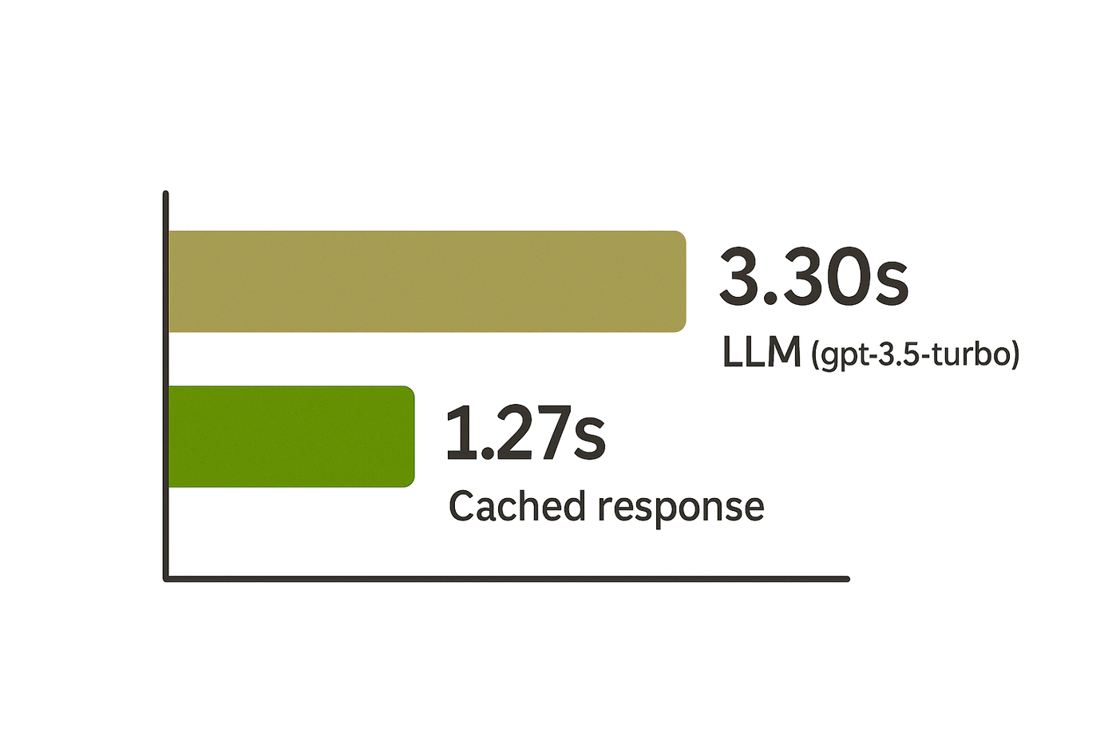

PROCESSING TIMES
LANGSMITH LATENCY

Slide 6




DEMO & CONCLUSION

Slide 7


